Slide 1
MLFSOM Simulations Gaussian Beam

Slide 2
MLFSOM input parameters
Crystal & Exp. Params
Protein | Tetragonal lyosyzme
PDB code | 1H87
Unit cell | 77.25, 77.25, 38.66
Detector | Pilatus 6M
Mosaicity (initial-final) | 0.05 – 1.00º
B-factor (initial-final) | 14.8 – 51.8 A²
Fractional unit cell change | 1% (at the end)
Initial resolution | 1.5 A
Oscillation (stills) | 0.01º
Number of frames | 10
Number of grids (hor x ver) | 6 x 6
Beam Params
Beam size (FWHM_hor x FWHM_ver) | 100 micron
Crystal size | 300 micron
Wavelength | 1.0 A
Beam dispersion | 0.00014
Beam divergence (hor, ver) | (0.06º, 0.01º)
Exposure per frame (exposure time at the center of the beam*) | 0.5 sec
Beam flux | 8.4 x 10¹⁰ ph/sec
Notes:
For the simulation purposes, I set the exposure time of each sub-crystal proportional with their flux. I could not change the flux itself in the program, thus I used variable exposure time for each sub crystal.

Slide 3
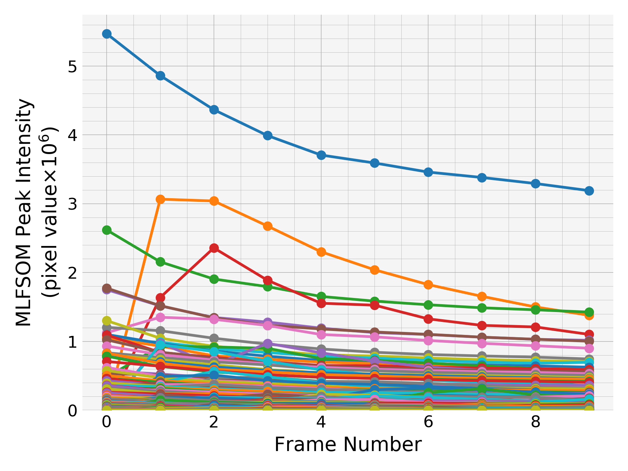
Evolution of peak intensities:
all peaks

Slide 4
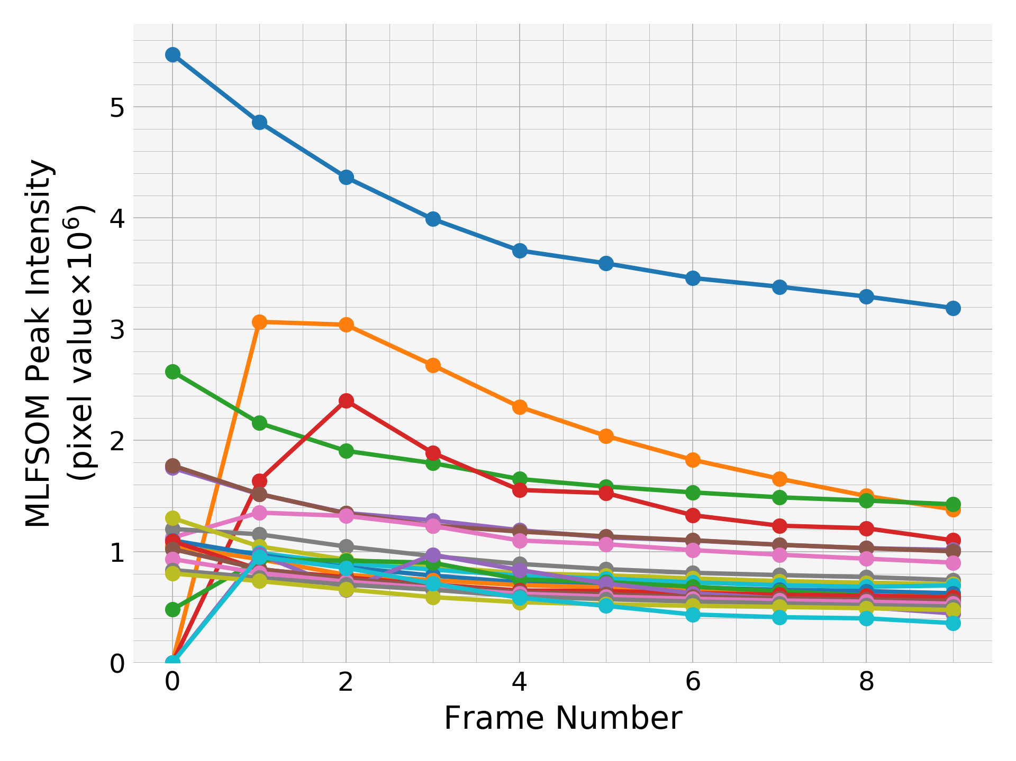
Evolution of peak intensities:
strongest 2o peaks
The brightest first 20 peaks (peaks are sorted by their average intensities over all frames)

Slide 5
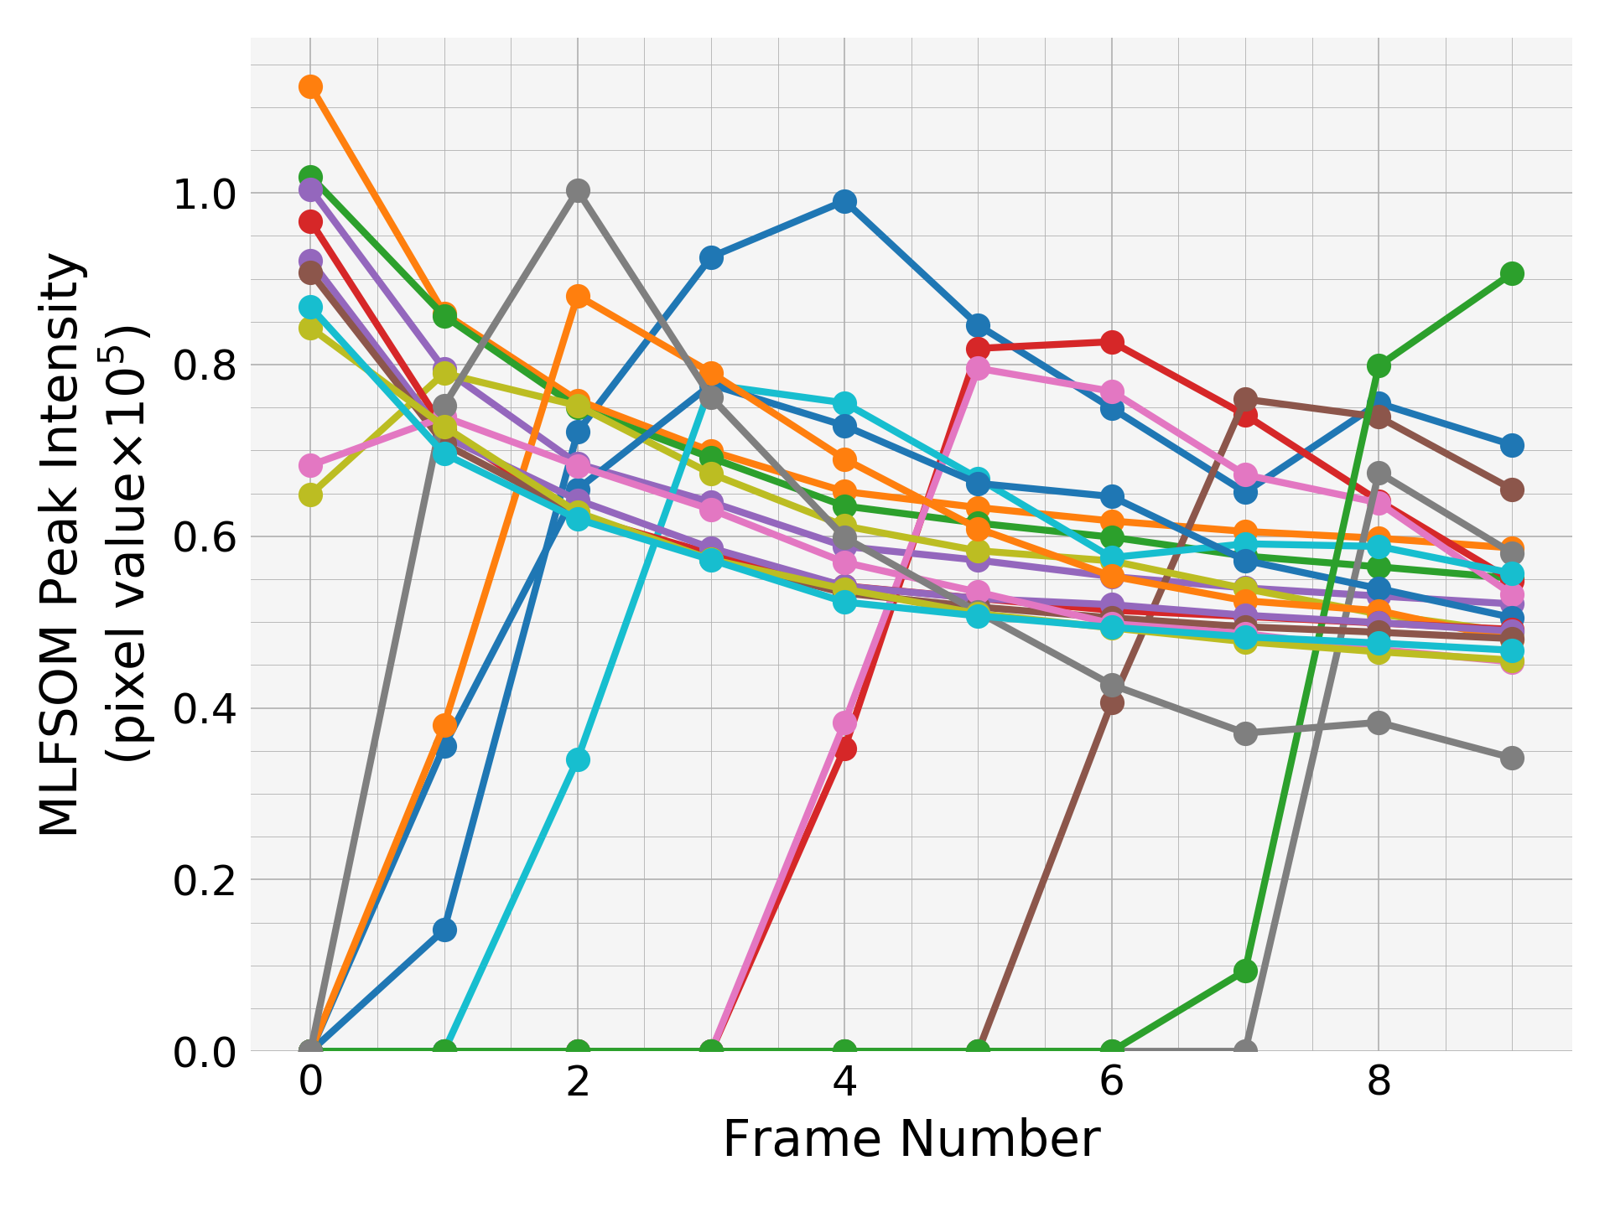
Evolution of peak intensities:
moderate-strong 2o peaks

Slide 6
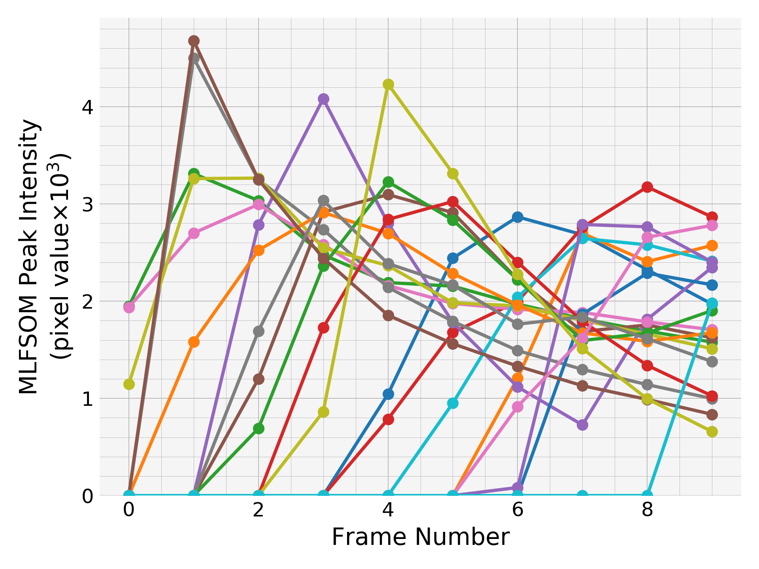
Evolution of peak intensities:
moderate 2o peaks

Slide 7
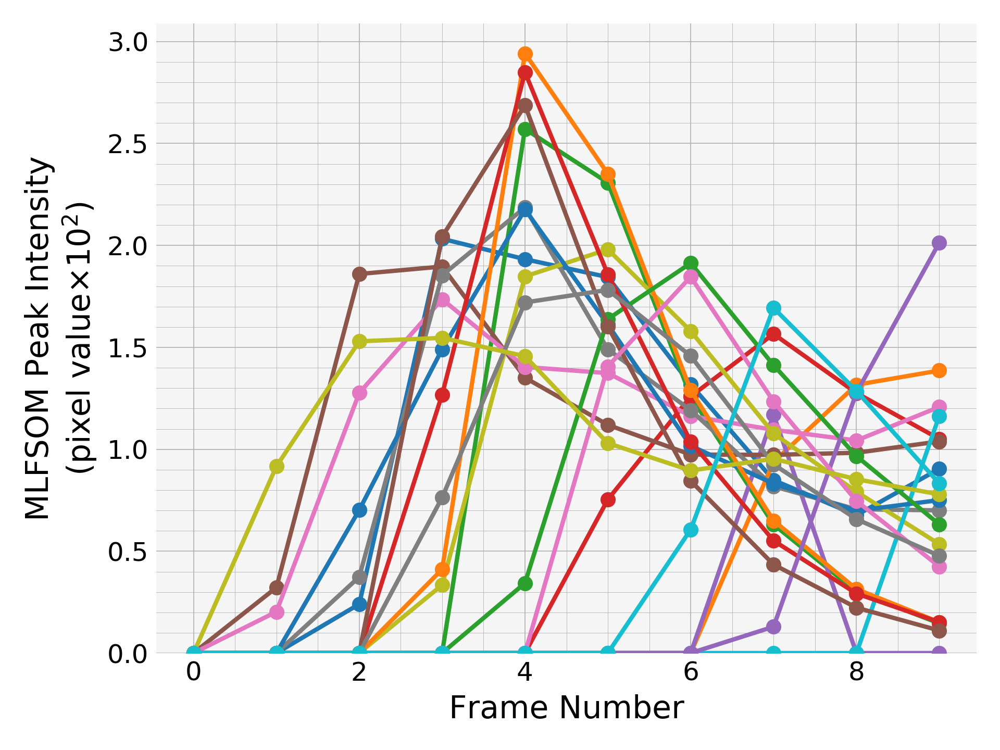
Evolution of peak intensities:
the weakest 2o peaks

Slide 8
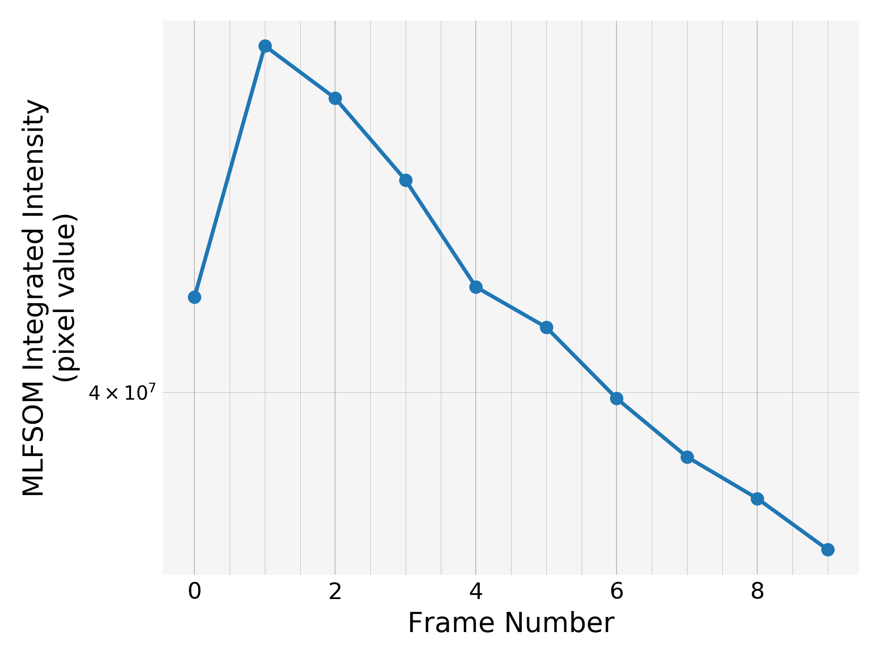
Integrated intensity
Integrated intensity decays very slowly compared to the homogeneous beam with the same starting and ending mosaicities, B-factors and unit cell. Gaussian beam drops by a factor of 1.6 or so while homogeneous beam decayed by a factor of 3.5.

Slide 9
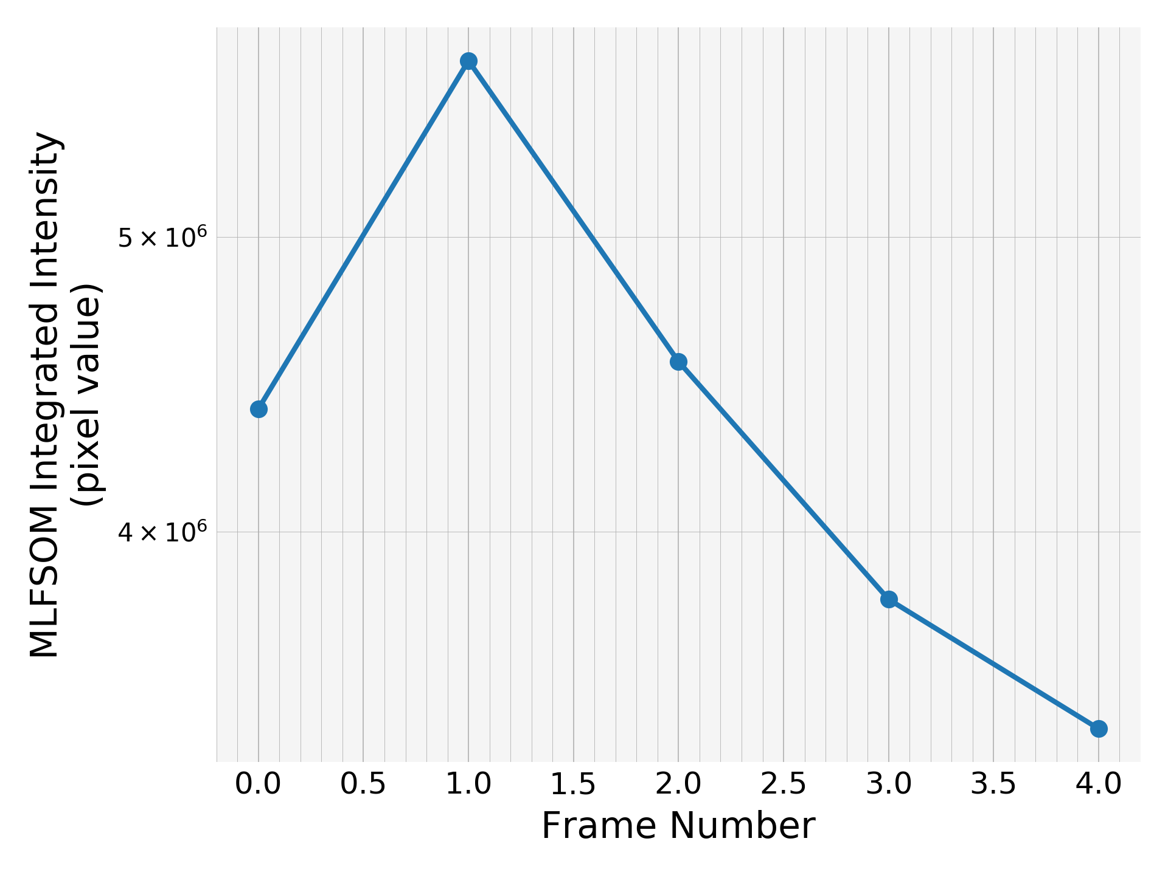
Integrated intensity
smaller grid size = 4x4
less number of frames = 5
Similar trend

Slide 10
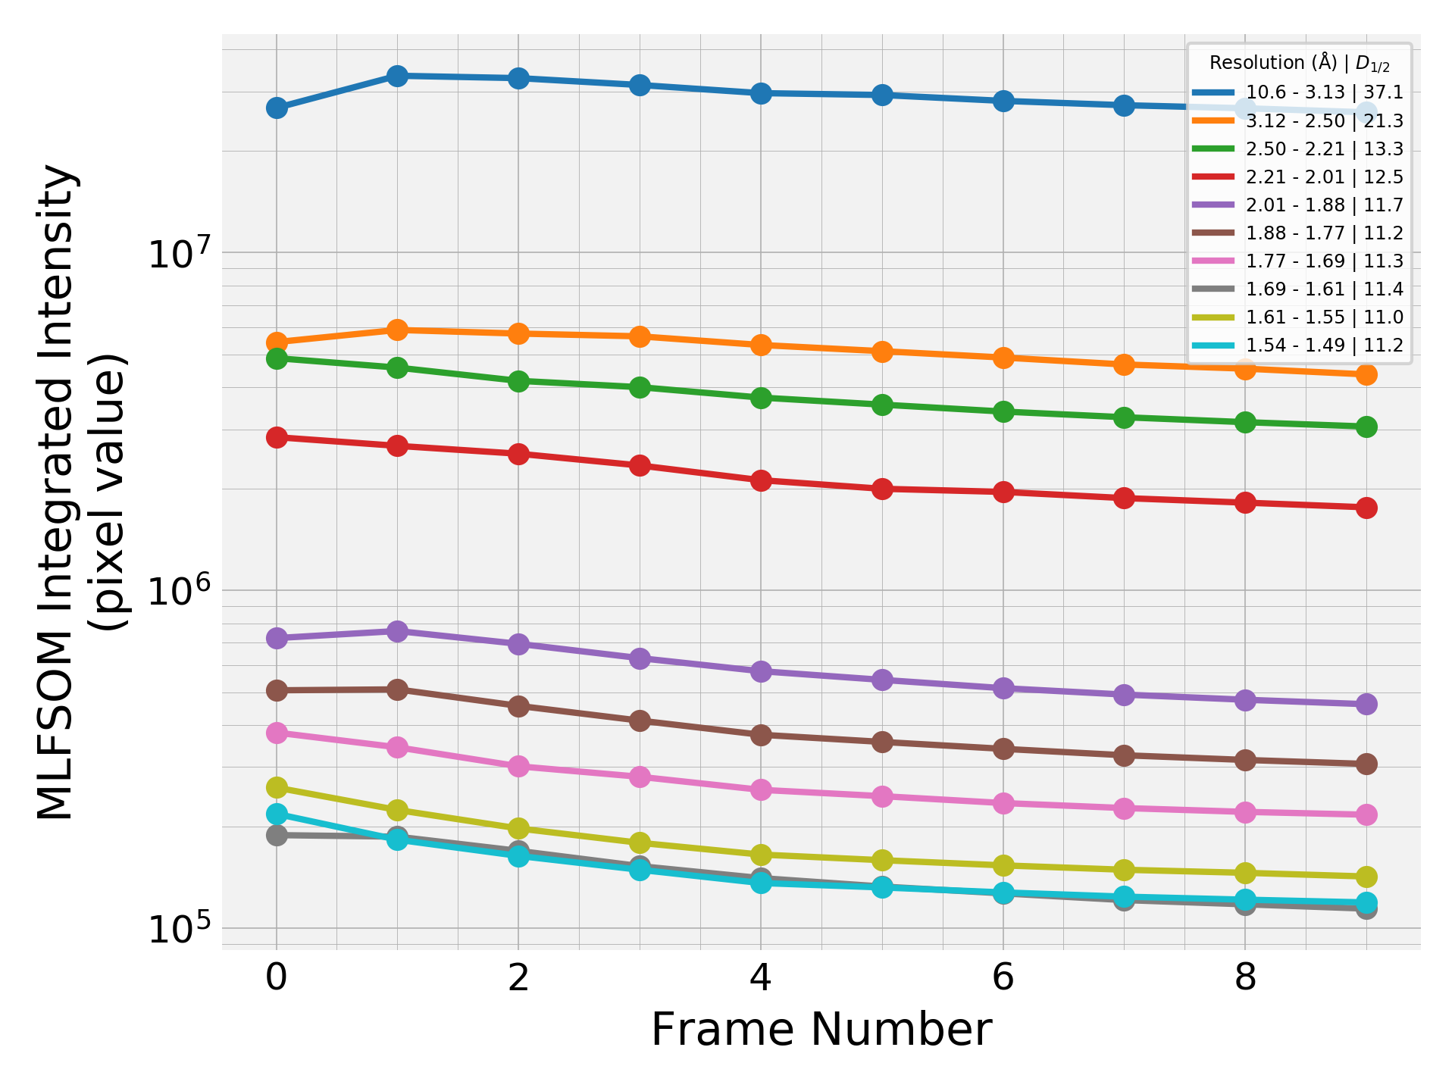
Integrated intensity by resolution shells
Curves of the high resolution shells are almost parallel to each other. Half-dose values almost don’t change after the second one from the top in the legend list.

Slide 11
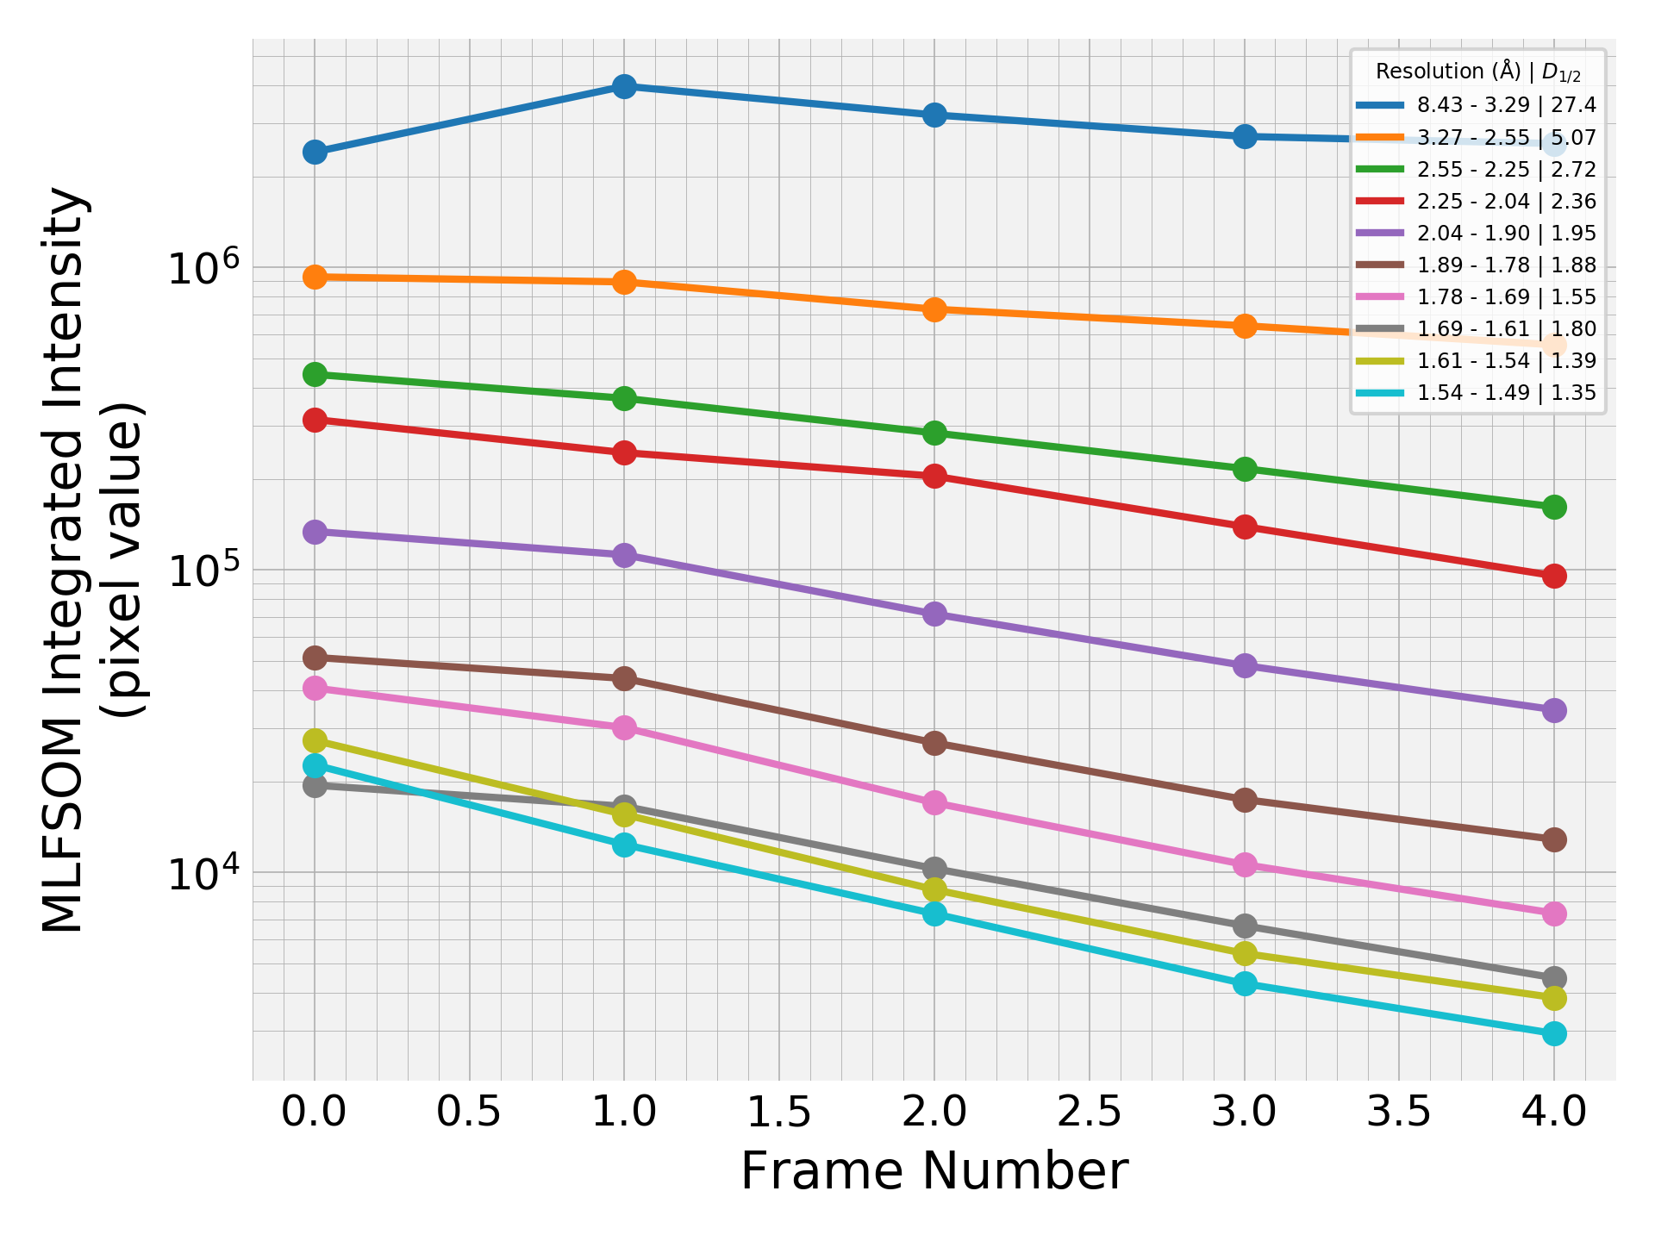
Integrated intensity by
resolution shells
smaller grid size = 4x4
less number of frames = 5
Similar trend

Slide 12
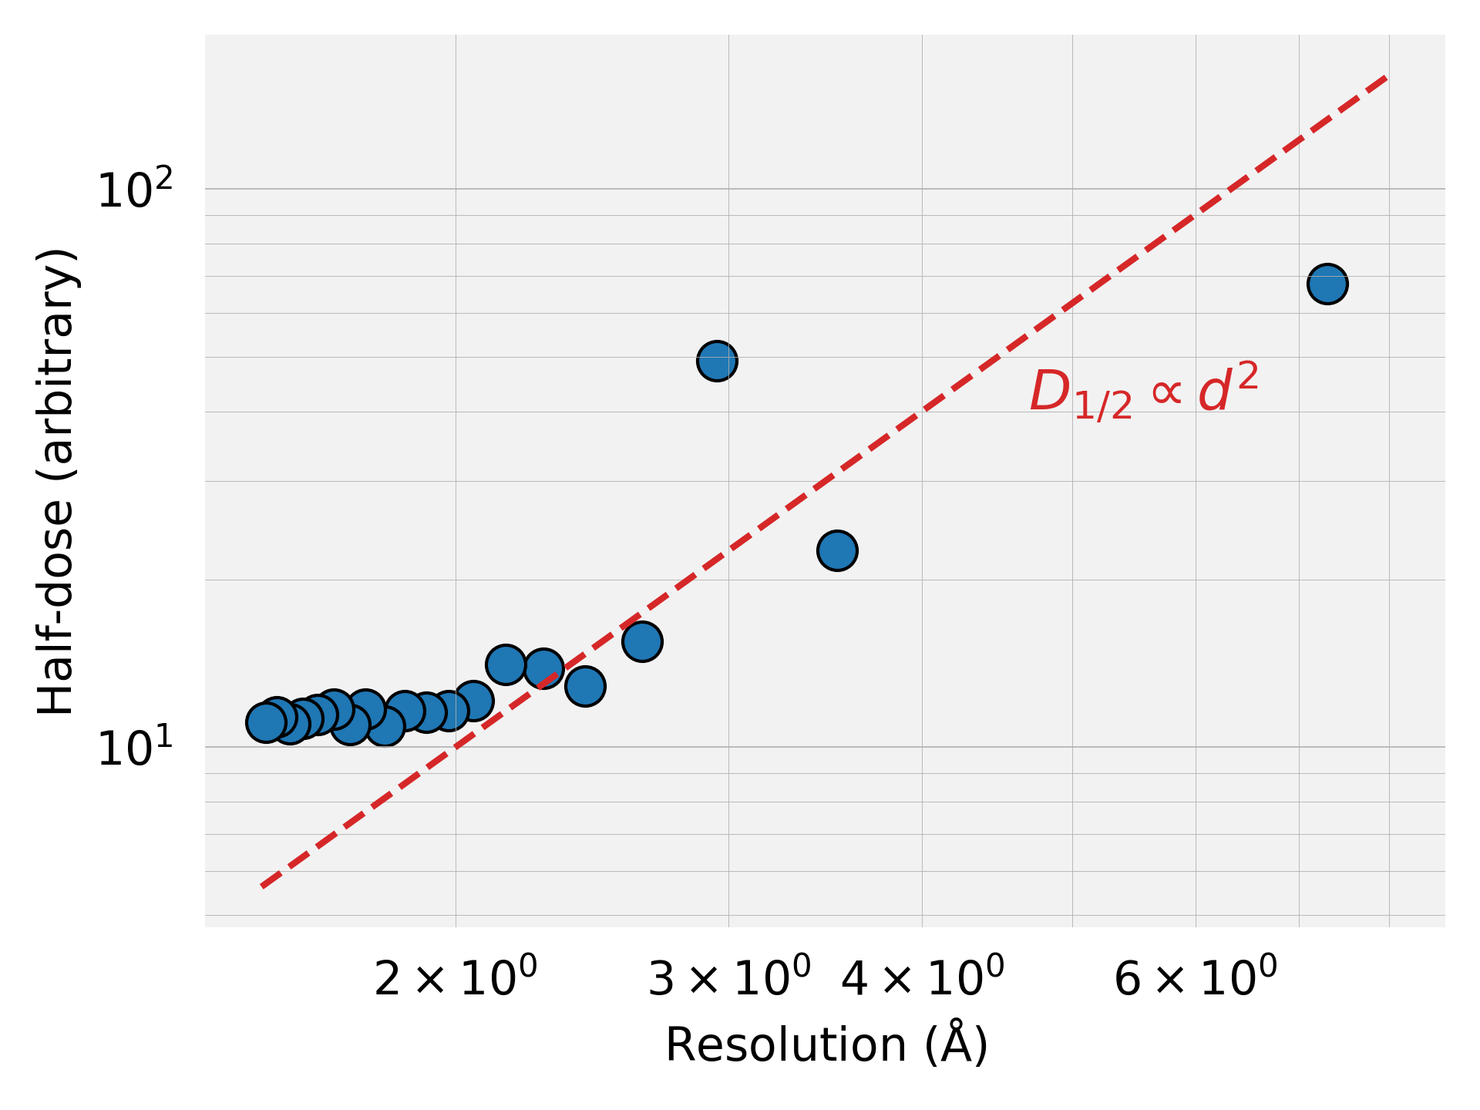
Half-dose vs. resolution
Definitely not proportional with d². It does not look like it is a power law fit at all.

Slide 13
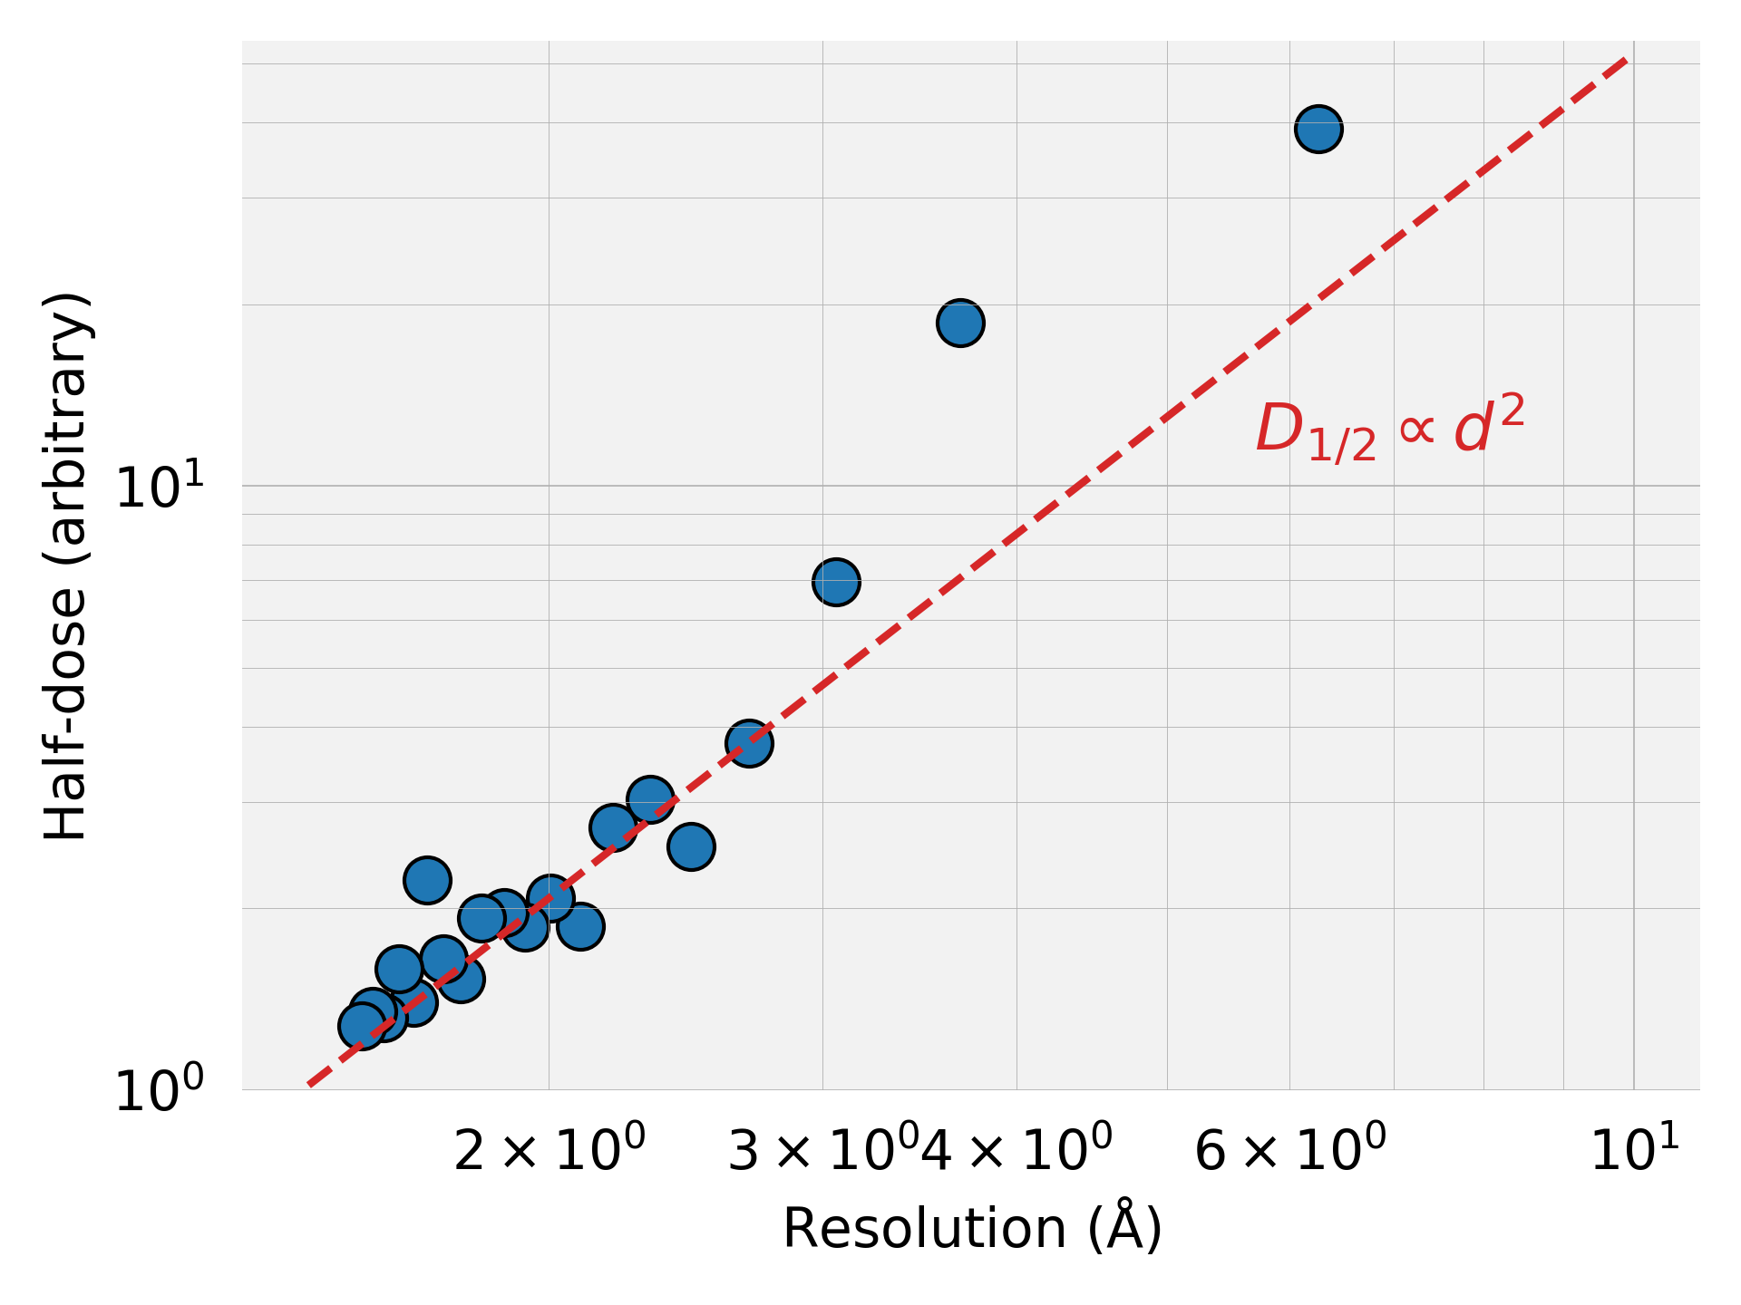
Half-dose vs. resolution
This looks slightly more power law but I think it is still not a good fit. Low resolution shells significantly deviate from the power law.

Slide 14
OBSERVATIONS & NOTES
We need to increase the grid size to get more accurate results for the gaussian beam case. The program runs in parallel on all available cores of the computer to speed up the process. However, quite frequently, it gets stuck and does not finish the simulation. That’s why I was able to get 6x6 grid size for now. I need to work on it a little to reach finer grids e.g. 10x10
I ran the gaussian beam simulations with 1.5 A resolution of initial intensity due to the time constraints. We would want to go for 1.2 A ish to get better stats i.e. to get a lot more peaks

